Slide 1

Notes:
#

Slide 2



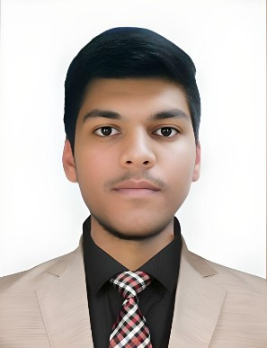
CHALLENGE
Our Solution QWEN-2VL-2B
Presenting by
AlgoDiverz
Yatish Kumar Verma
Computer Science Engineering (4th Year)
Government Engineering College, Mainpuri
Pranav Mittal Mathematics & Data Science (3rd Year)
Maulana Azad National Institute of Technology, Bhopal
Date of Submission: 20 Oct. 2024

Slide 3

Executive Summary
Our solution addresses the problem statement 'Smart Vision for Quality Control' in the Flipkart Grid 6.0 Robotics challenge.
Automates quality control using Qwen-2VL-2B model.
Extracts product details like name, category, expiry, and freshness from images( Packed, Fruits & Vegetables).
Ensures real-time product validation with computer vision and NLP.
Enhances accuracy in product quality analysis and shelf life prediction.

Slide 4
Technical Approach
Model Setup: Utilized Qwen-2VL-2B for image-text analysis.
Data Extraction: Extracted product details using NLP and computer vision.
Image Processing : Processed images with PIL and OpenCV.
Automated Analysis : Applied regex to extract structured data from output.
Data Storage : Saved results to Excel using openpyxl.

Slide 5

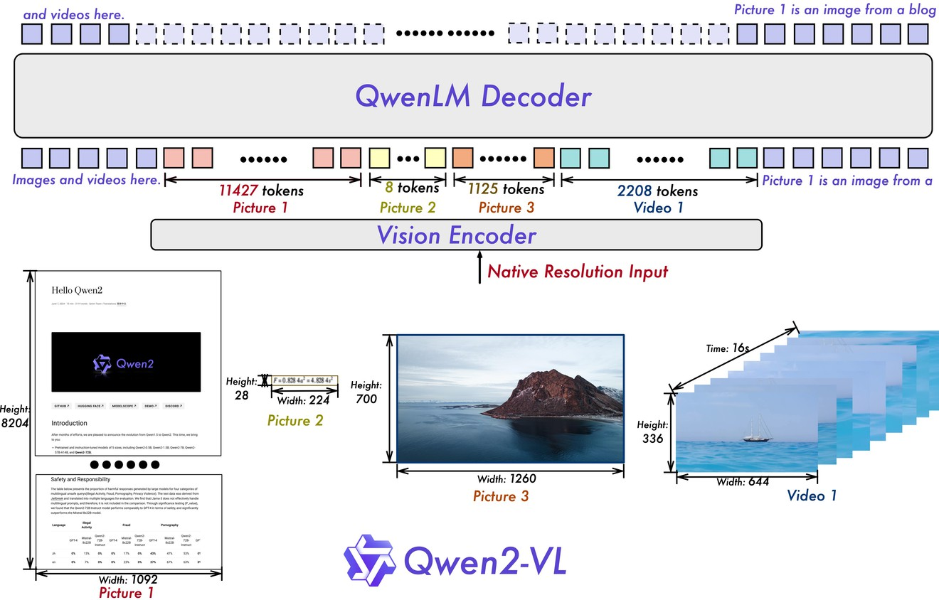
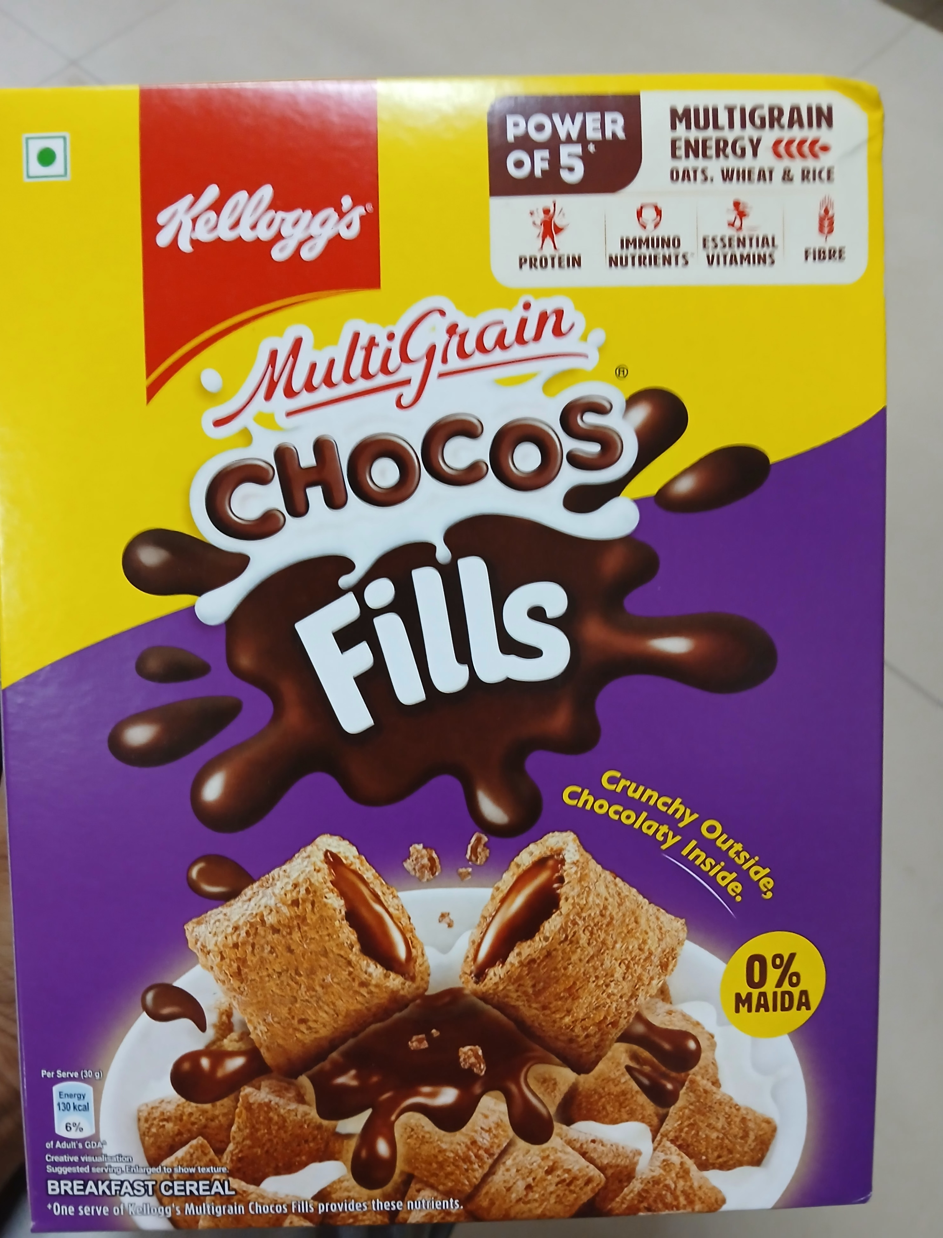
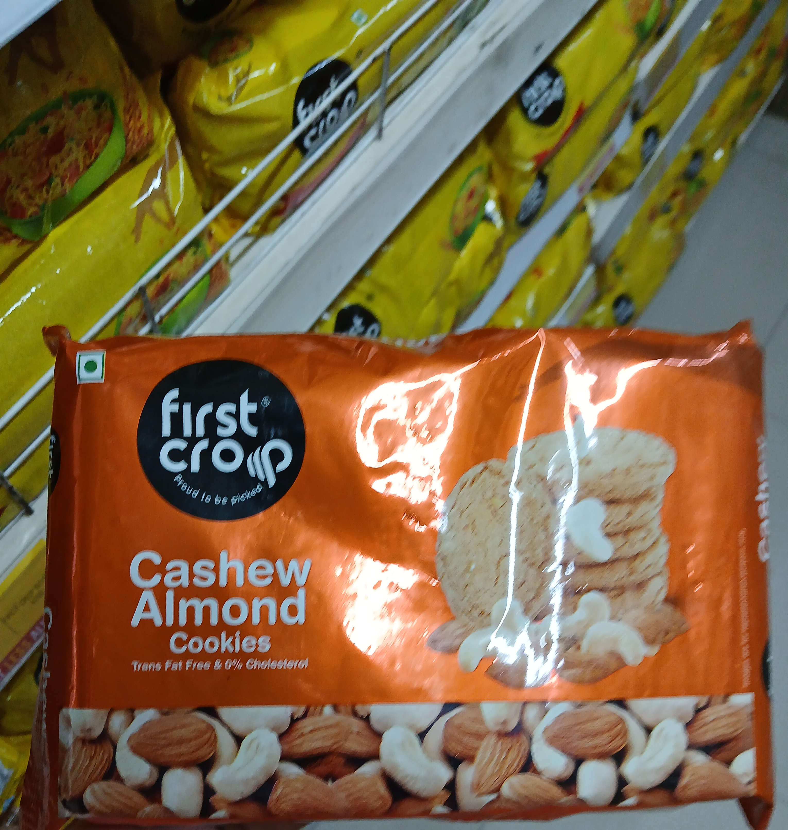
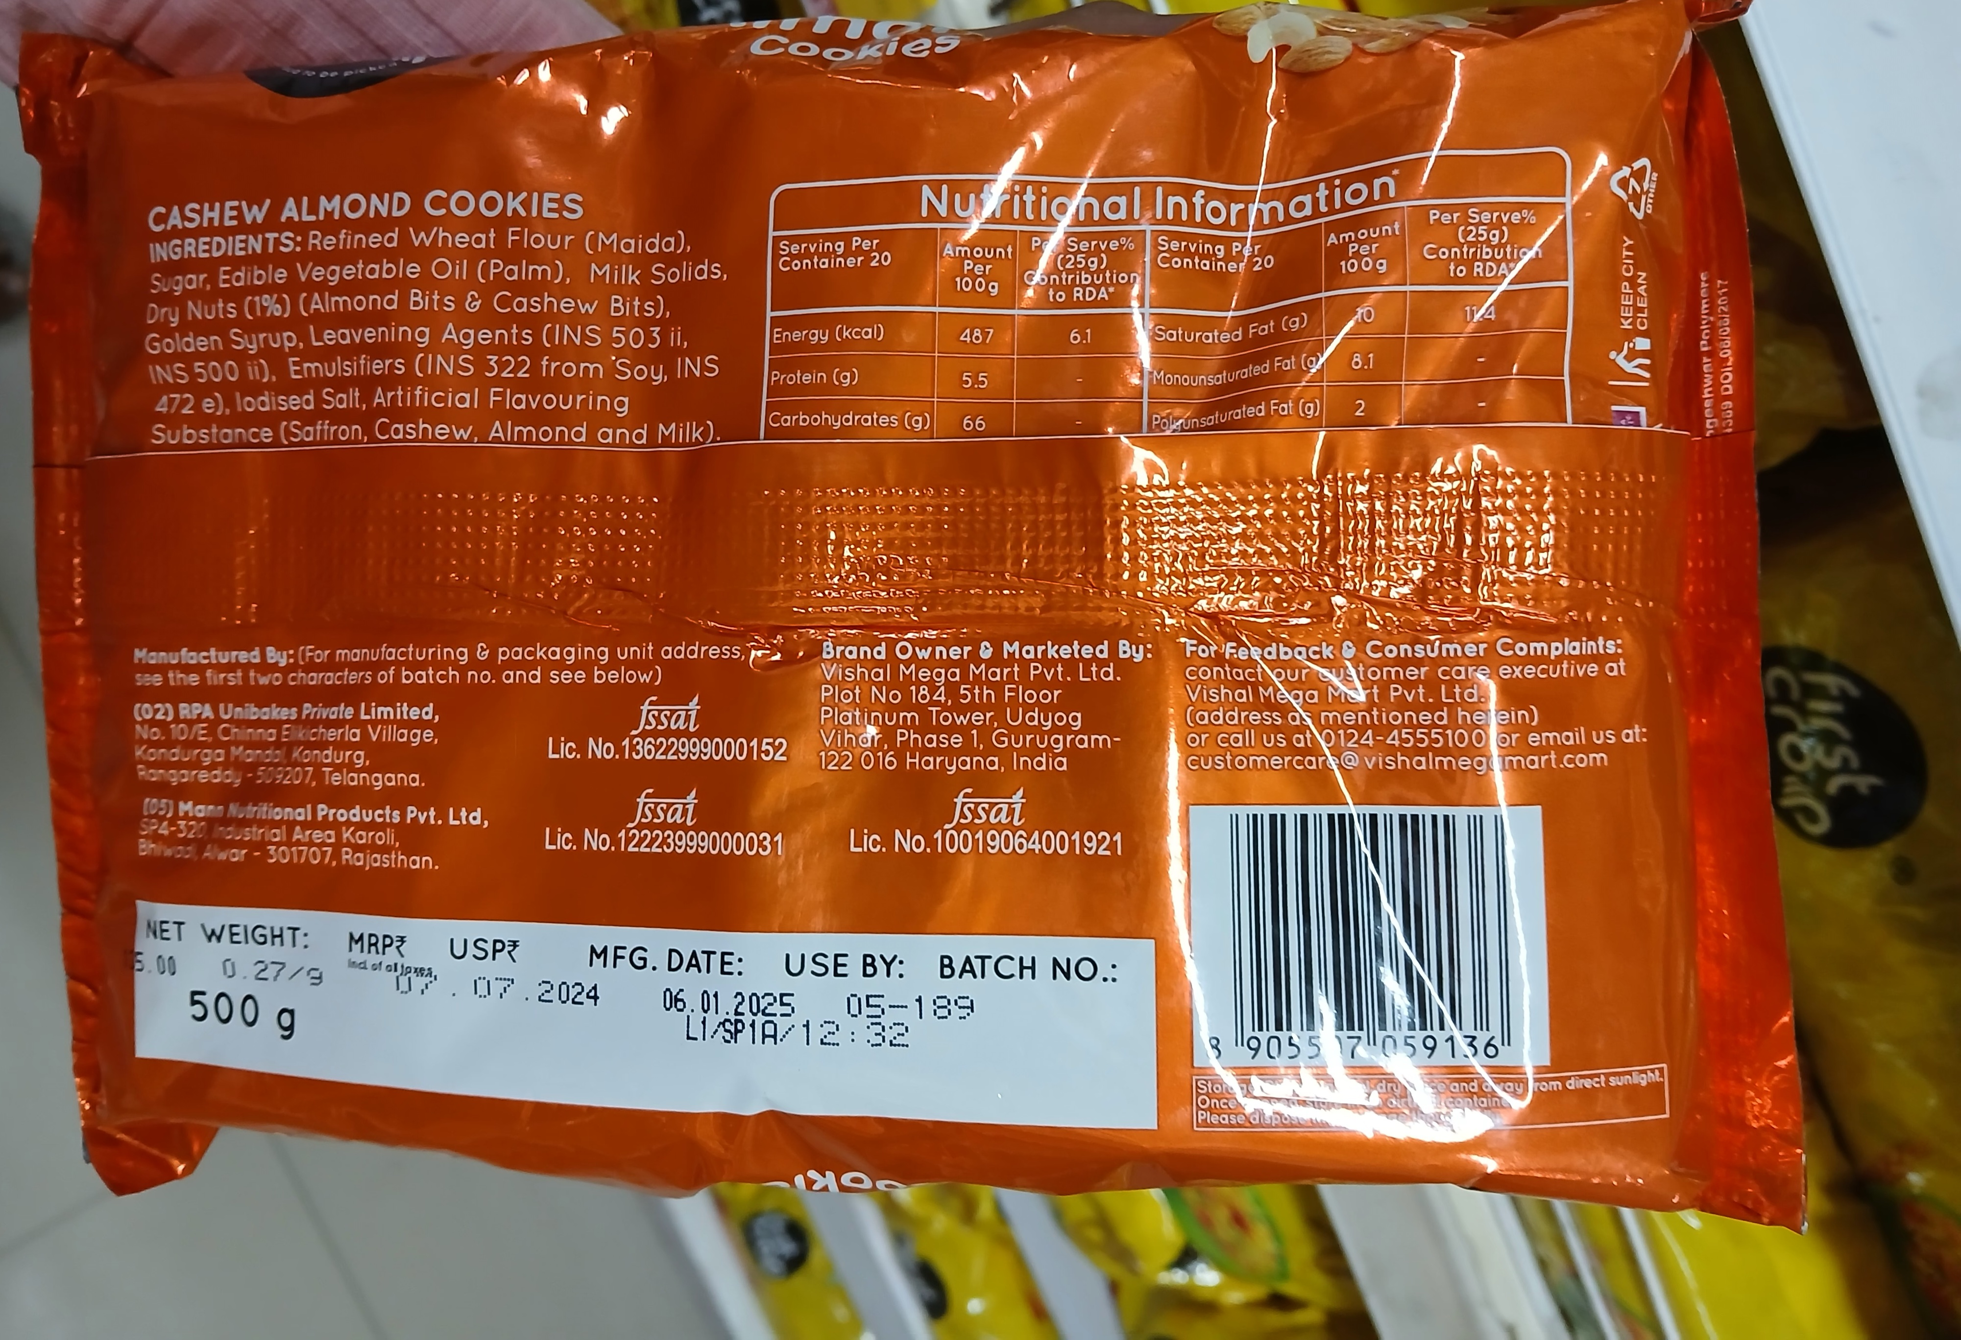
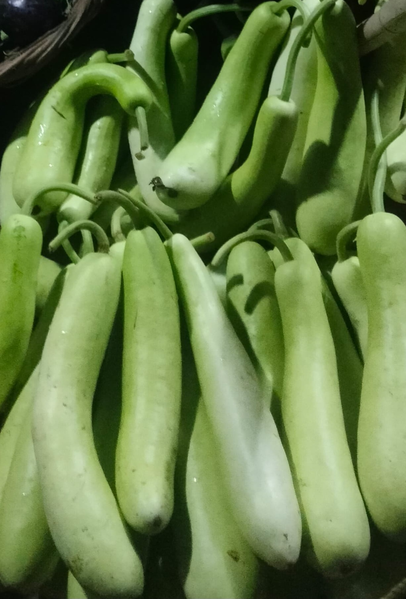
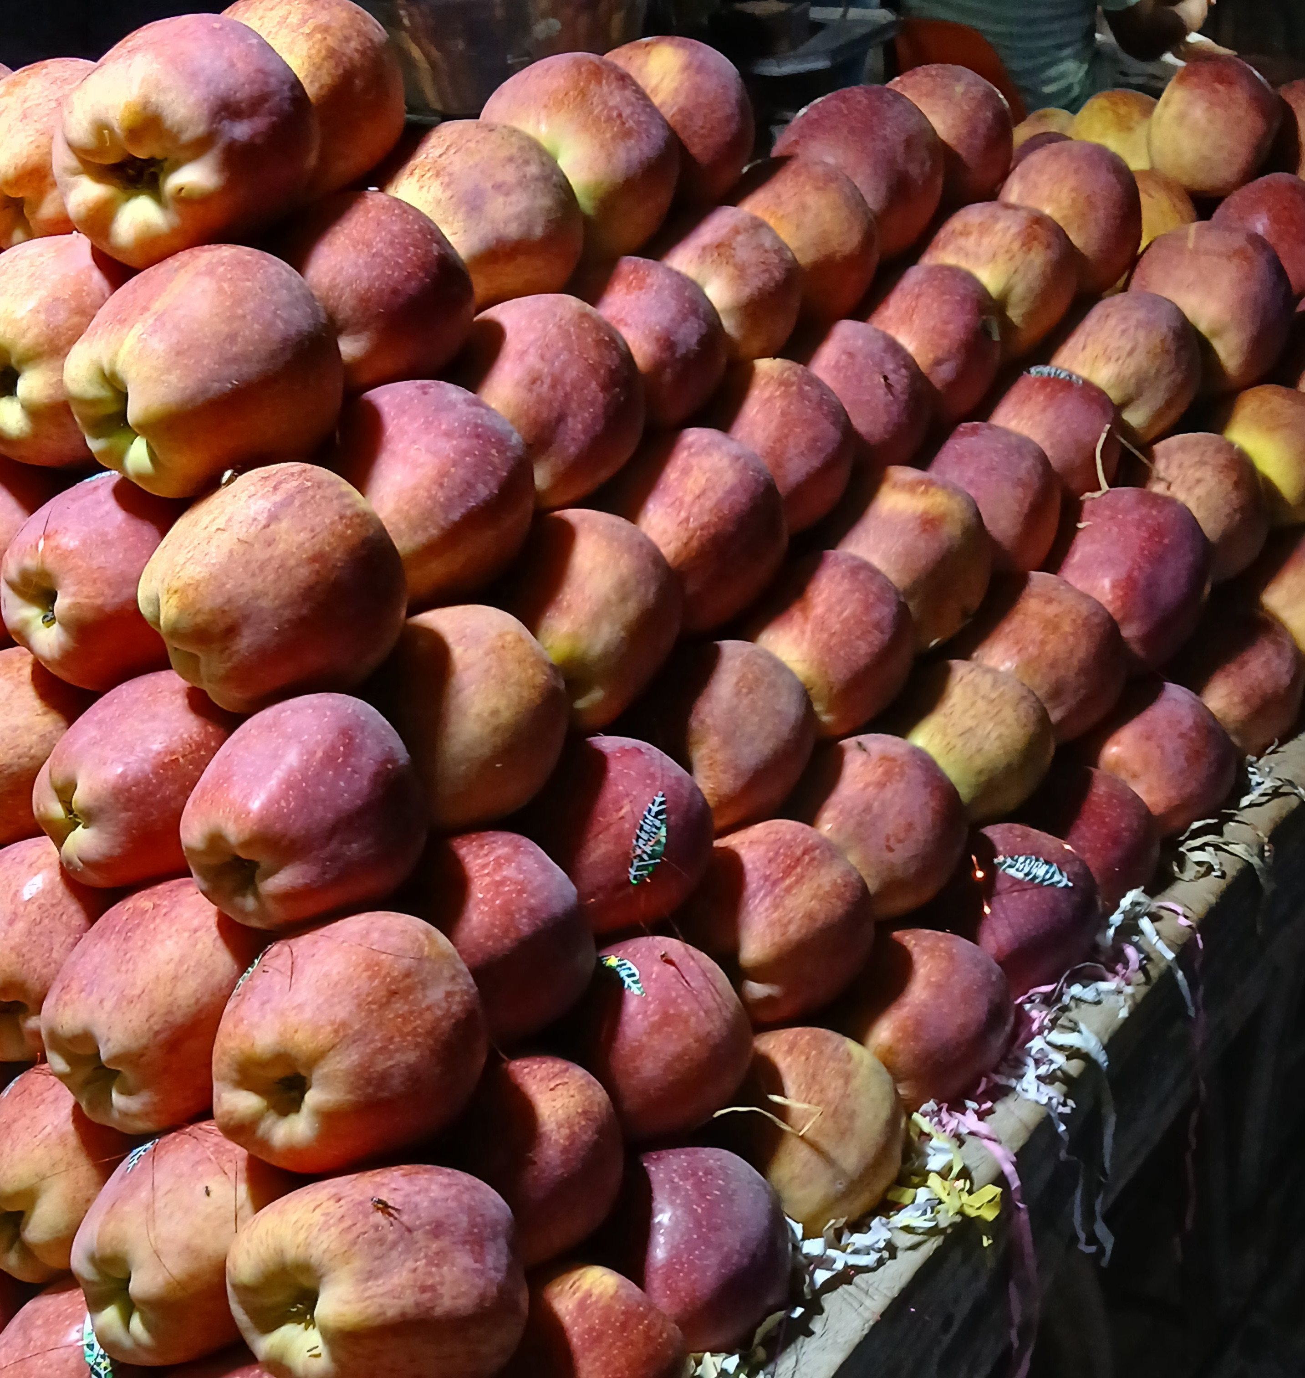
Why Hugging Face Model?
Pre-trained Excellence
Multi-Modal Capability
Ease of Integration
Customizable
Community Support

Slide 6
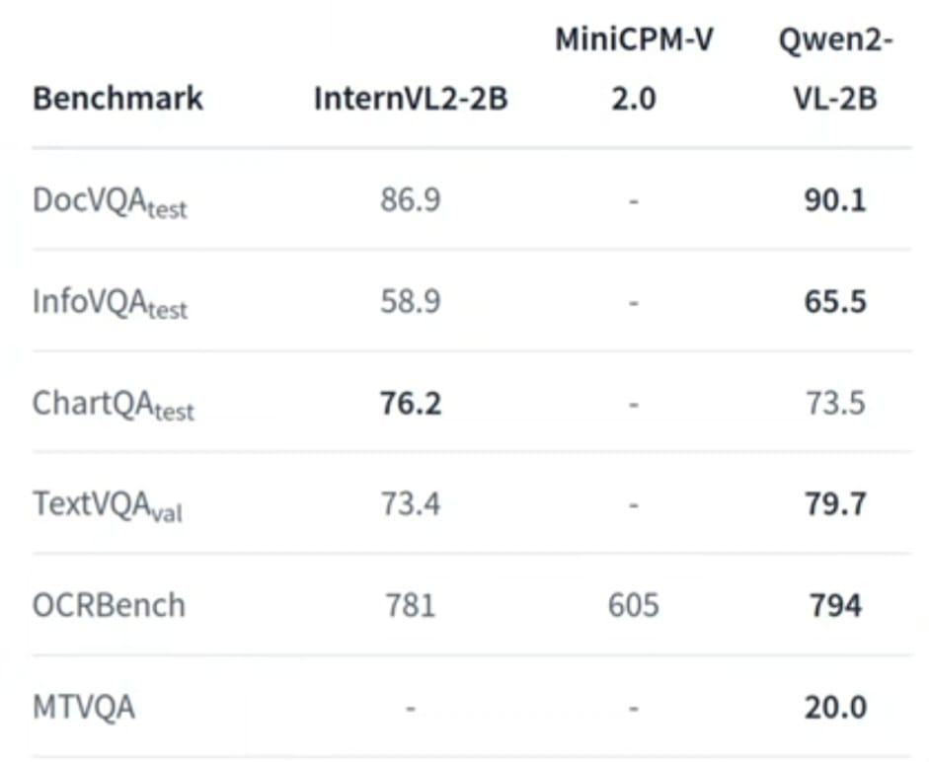

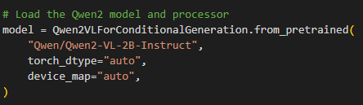
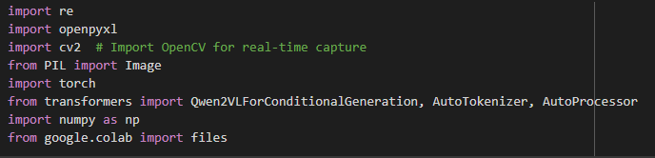
Why Qwen-2VL-2B?
Vision-Language Alignment
High Accuracy
Open-Source
Optimized For Real-World
Pre-Trained on VQA & OCR Dataset
Base Model: Qwen2VL-2B-Instruct
Data Preprocessing
Image and Text Normalization
Data Augmentation for Robustness
Structured Output Preparation

Slide 7

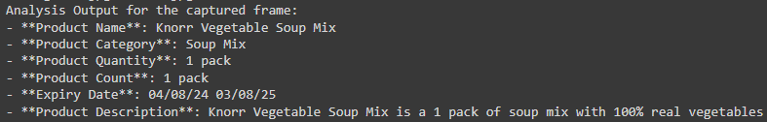

Implementation
Results
Qwen-2VL-2B for analysis.
Image processing with PIL/OpenCV.
NLP for product details.
Results stored in Excel.
Accurate product extraction.
Automated grocery quality control.
Real-time structured analysis.
For Fruits/Vegetables:
For Packed Items:

Slide 8


References
Future Scope
Our Model on:
Google Collaboratory : Link
Open Source on:
Hugging Face: Model
Project uploaded also on:
Github: Repository
Faster Processing
Industry
Expansion
Product Description Generation
AI-Powered
Automation
Visual Search
Enhanced
Real-Time Analysis
Higher Accuracy
Multilingual Support

Slide 9
Thank You !

